Slide 1
Openwrt-UCI Introduction
Frank
2022.Apr

Slide 2
Openwrt-UCI
The UCI System
Basic Rule
UCI init flow
UCI Init Script Cmd
Example Init Script
Config File Syntax
UCI Cmd Table
UCI Cmd Example
Precautions for UCI
How to USE UCI config?
Shell Script
C language API

Slide 3

The UCI System
UCI(Unified Configuration Interface)
OpenWrt會將各個功能或者模組配置各個屬於其之設定值(configuration)。
此模組的目的是集中管理OpenWrt中各個模組的設定值。
對於OpenWrt而言，可以將UCI視為系統中主要使用者操作介面，用來操作系統中最重要的設定項目。

Slide 4
Basic Rule
OpenWrt的設定值 (configuration)
OpenWrt中主要的設定值，依照模組被切割成好幾個獨立的檔案(UCI設定檔)，存放在系統的 /etc/config/ 目錄之中。
使用者可以透過文字編輯器(vi…)、UCI指令、Web GUI，來修改UCI設定檔。

Slide 5
UCI init flow
Power ON
boot
rc.d
Execute daemons according to the boot sequence
init.d
Bringup
Application
Script enable initscript
Generate /etc/rc.d/SXXConfig
Ex:
/etc/rc.d/S20network
Load etc/config
Bring up Application

Slide 6
UCI init flow
rc.d
Execute daemons according to the boot sequence
init.d
Script enable initscript
Generate /etc/rc.d/SXXConfig
Ex:
/etc/rc.d/S20network
Bringup
Application
Load etc/config
To cache(/tmp)
Daemon
Start
Daemon
Start
Daemon
Start
Cache
tmp/config
Cache
tmp/config
Cache
/tmp
Execute the Daemon or according to the config settings

Slide 7
UCI Init Script Cmd
CMD : /etc/int.d/[daemons] Command
EX: /etc/init.d/network start
daemons : application init script
Commands:
start Start the service
stop Stop the service
restart Restart the service
reload Reload configuration files (or restart if that fails)
enable Enable service autostart
disable Disable service autostart

Slide 8
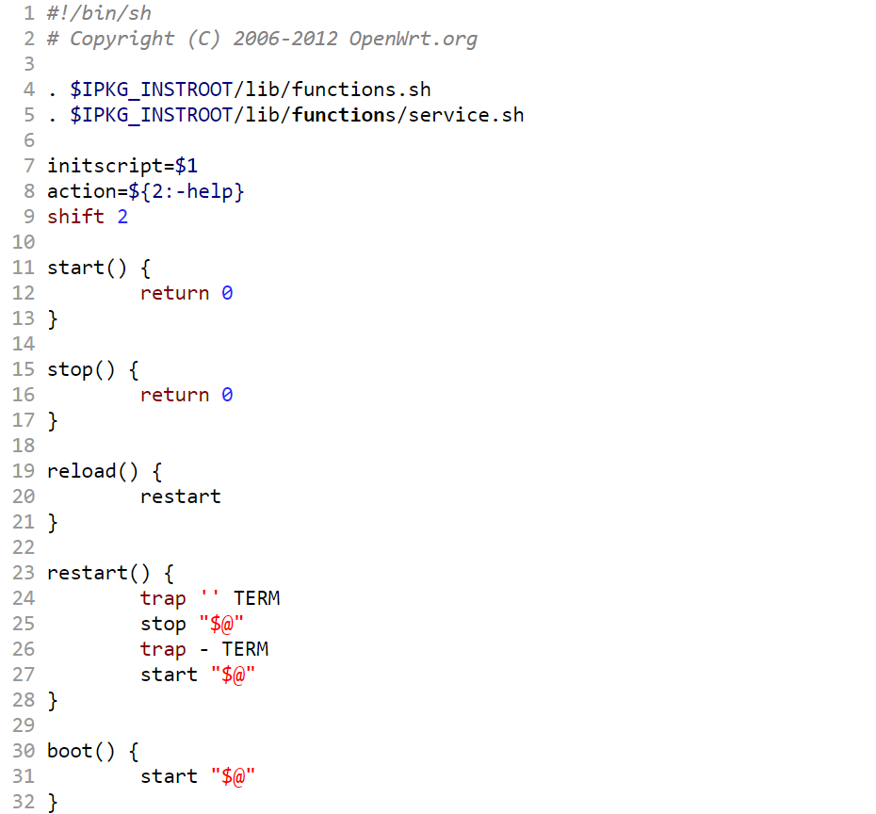
rc.common

Slide 9
Example Init Script
Code
#!/bin/sh /etc/rc.common # Example script # Copyright (C) 2007 OpenWrt.org START=10 STOP=15 start() { echo start # commands to launch application } stop() { echo stop # commands to kill application }
Rc.common 在使用 enable 之時依據START Value 在rc.d中建立 SXXdaemons
Rc.common 在使用 enable 之時依據START Value 在rc.d中建立 KXXdaemons

Slide 10
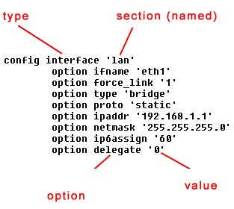
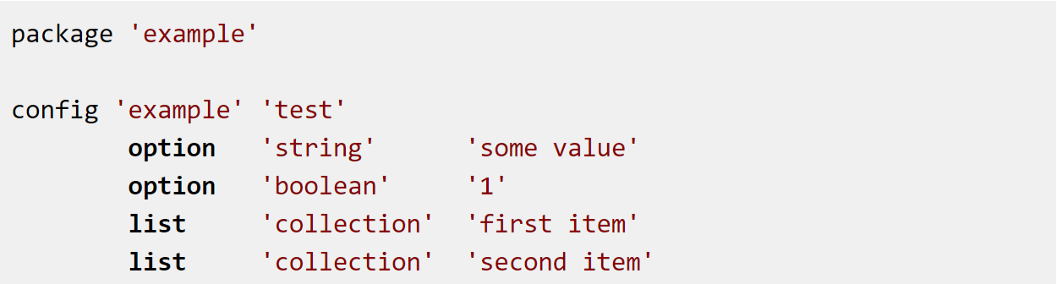
Config File Syntax
各個Daemons的Config會放置在/etc/config之中，由該服務的initScript將其Load到Cache(tmp)中，下圖為Config的語法風格

Slide 11
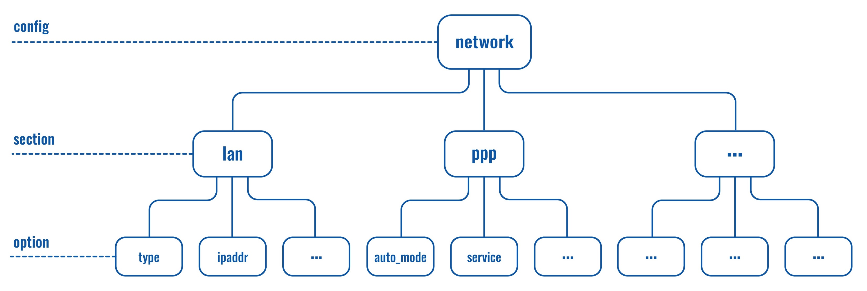
Config tree architecture
Reference : https://wiki.teltonika-networks.com/view/File:Uci_config_hierarchy_v3.jpg

Slide 12
Config List
基本配置
/etc/config/dhcp | dnsmasq和DHCP的設置
/etc/config/dropbear | SSH伺服器選項
/etc/config/firewall | 防火牆設置
/etc/config/network | 交換，Port和路由設置
/etc/config/system | 雜項與系統配置
/etc/config/timeserver | rdate的時間伺服器列表
/etc/config/wireless | 無線網路的設置與定義

Slide 13
UCI Cmd Table
命令操作：
uci [<options>] <command> [<arguments>]
Options:
-c <path> set the search path for config files
-d <str> set the delimiter for list values in uci show
-f <file> use <file> as input instead of stdin
-m when importing, merge data into an existing package
Reference :https://www.twblogs.net/a/5b7d06d02b71770a43dd962e

Slide 14
UCI Cmd Table
命令操作：
uci [<options>] <command> [<arguments>]
顯示全部uci配置：uci show
獲取節點：uci get
增加節點到檔案：uci add
增加一個值到選項(列表)：uci add_list
修改節點(選項)到檔案：uci set
刪除指定名字的節點：uci delete
顯示未生效的修改記錄：uci changes
生效修改：uci commit
Reference : https://www.itread01.com/content/1548832886.html

Slide 15
UCI Cmd Table
命令操作：
uci [<options>] <command> [<arguments>]
config:檔名 section:節點名 option:選項名
export [<config>]
import [<config>]
changes [<config>]
commit [<config>]
add <config> <section-type>
add_list <config>.<section>.<option>=<string>
del_list <config>.<section>.<option>=<string>
Reference :https://www.twblogs.net/a/5b7d06d02b71770a43dd962e

Slide 16
UCI Cmd Table
命令操作：
uci [<options>] <command> [<arguments>]
config:檔名 section:節點名 option:選項名
show [<config>[.<section>[.<option>]]]
get <config>.<section>[.<option>]
set <config>.<section>[.<option>]=<value>
delete <config>[.<section[.<option>]]
rename <config>.<section>[.<option>]=<name>
revert <config>[.<section>[.<option>]]
reorder <config>.<section>=<position>

Slide 17
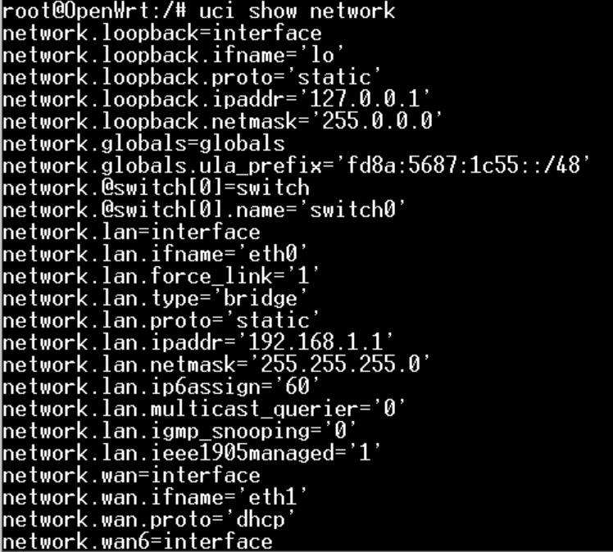
UCI Cmd Example
命令操作 show ：
uci show config

Slide 18
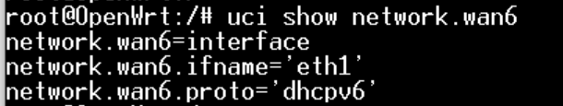
UCI Cmd Example
命令操作 show ：
uci show config.section
uci show config.section.option

Slide 19
UCI Cmd Example
命令操作 get ：
uci get config.section
uci get config.section.option

Slide 20
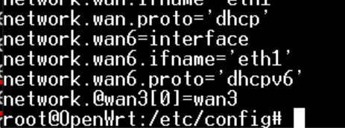
UCI Cmd Example
命令操作 add ：
uci add config section
uci show config

Slide 21

UCI Cmd Example
命令操作 add_list：
uci add_list config.section.option=‘value’
uci show config

Slide 22
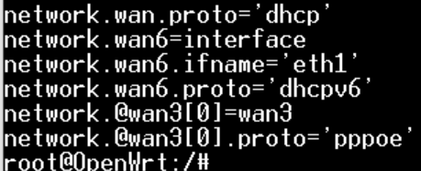
UCI Cmd Example
命令操作 set ：
uci set config.section.option=value
uci show config

Slide 23
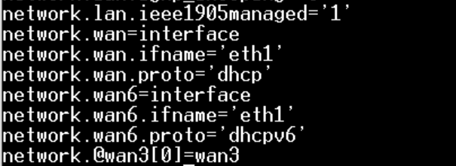
UCI Cmd Example
命令操作 delete ：
uci delete config.section.option
uci show config

Slide 24
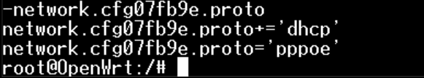
UCI Cmd Example
命令操作 changes ：
uci changes config
uci show config

Slide 25
UCI Cmd Example
命令操作 revert ：
uci revert config

Slide 26
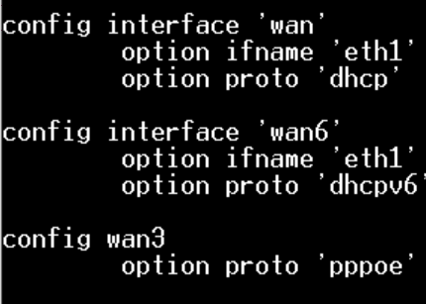
UCI Cmd Example
命令操作 commit ：
uci commit config
uci show config

Slide 27
UCI init flow
rc.d
Execute daemons according to the boot sequence
init.d
Commit modify etc/config so we need restart the init Script
Script enable initscript
Generate /etc/rc.d/SXXConfig
Ex:
/etc/rc.d/S20network
Bringup
Application
Load etc/config
To cache(/tmp)
Daemon
Start
Daemon
Start
Daemon
Start
Cache
tmp/config
Cache
tmp/config
Cache
/tmp
Execute the Daemon or according to the config settings

Slide 28
Precautions for UCI
UCI的名稱(Label)以及設定文件中
只允許字母大小寫a~z 、0~9數字與”_”，”-”是不允許的
選項的值(value)可以允許任何字符但必須將引號括好 如:”value” or ‘ value ’
Section允許不含有名稱，但一定要標示其type
EX:
config bar 'first'
option name 'Mr. First'
config bar
option name 'Mr. Second'
config bar 'third'
option name 'Mr. Third'
稱為匿名節點

Slide 29
Precautions for UCI
UCI語法的容錯
允許:
option example value
option 'example' value
option example "value"
option "example" 'value'
option 'example' "value"
不允許
option 'example" "value'
option example some value with space

Slide 30
How to use UCI config?
在functions.sh(rc.common有include)中定義了在Script中得到UCI設置資訊的API
config_load <daemons>：
載入/etc/config中的daemons設置文件。
config_get <variable> <section> <option>：
讀取option將其值設置到variable中。
config_set < section > < option> < value> ：
將value設置到某一個option之中(只修改在Shell evn )

Slide 31
Example Script

Slide 32
UCI Cmd Example
執行Script：./networkex <command> <IP>
Command: start stop ….
IP:欲修改的LAN IP address
功能:
Show uci network config
Show uci interface & protocal
Modify lan ip address
Show modified part
Confirm whether to modify

Slide 33
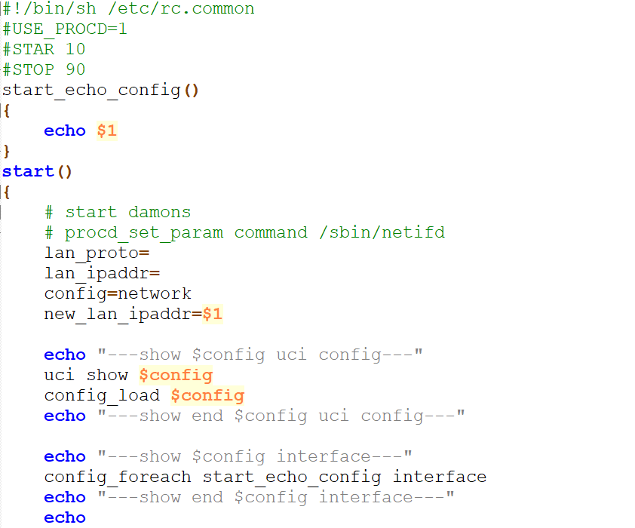
UCI Cmd Example
設置執行環境 必須要有rc.common
STAR與STOP為LINK daemon在rc.d的啟動順序
Load network uci config
遍歷 network interface
執行start_echo_config

Slide 34
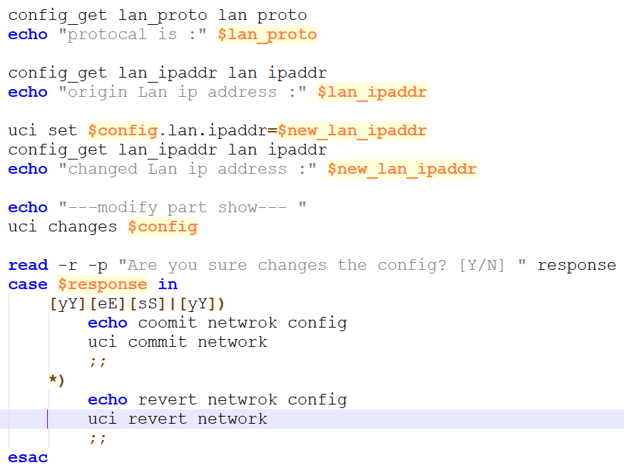
UCI Cmd Example
Get lan proto,ipaddr value
Set lan ipaddr value
查看變更了那些設定
Commit network的設定
取消 network修改的設定

Slide 35
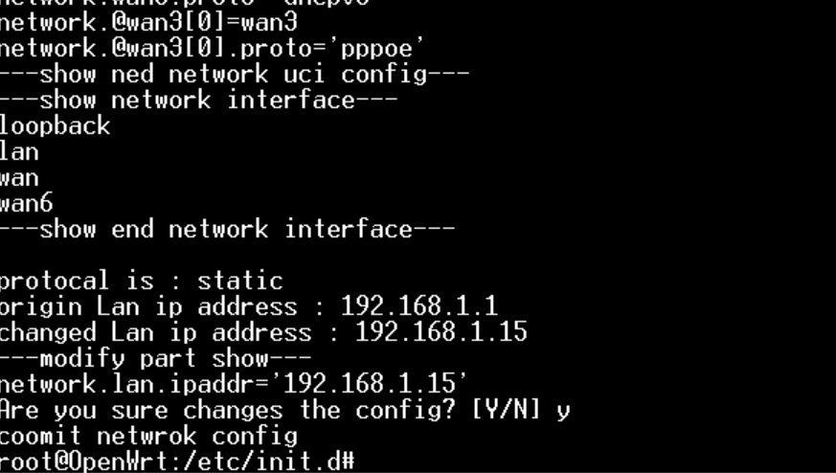
UCI Cmd Example

Slide 36
UCI C API
uci.h中定義了在C語言中使用UCI的API。
#include <uci.h>
結構體 | 說明 | 對應函式
uci_context | UCI上下文，用於存儲配置路徑、配置package等，使用uci前必須分配一個ctx | uci_load uci_unload uci_alloc_context uci_free_context….
uci_package | 對應一個UCI config，如network、wireless | uci_lookup_package uci_load uci_unload
uci_section | 對應配置的一個節點(section) | uci_lookup_section
uci_option | 對應某個選項(option) | uci_lookup_option_string uci_lookup_option
uci_ptr | 修改與新增UCI config時所使用的結構 | uci_set uci_commit uci_unload

Slide 37
UCI C API
uci.h中定義了在C語言中使用UCI的API。
#include <uci.h>
API | 說明
uci_alloc_context | alloc uci context
uci_free_context | Release uci context
uci_load | Load uci config
uci_unload | Unload uci config
uci_lookup_ptr | Search configuration data

Slide 38
UCI C API
uci.h中定義了在C語言中使用UCI的API。
#include <uci.h>
API | 說明
uci_set | Set config
uci_delete | Delete config
uci_save | Load uci config
uci_commit | commit package

Slide 39
Example UCI C API
Detail parameter description :
https://blog.csdn.net/dxt1107/article/details/115742249

Slide 40
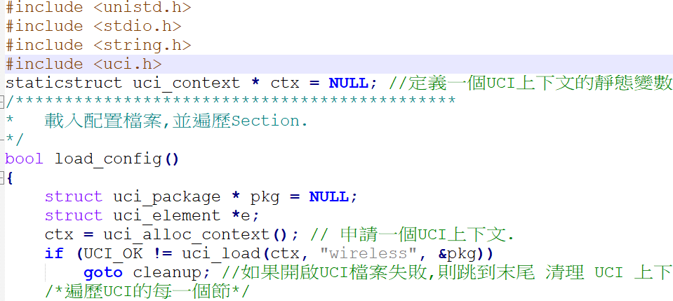
Example UCI C API
Include uci
Uci 內容存放之變數
alloc uci context
Load uci config wirless

Slide 41
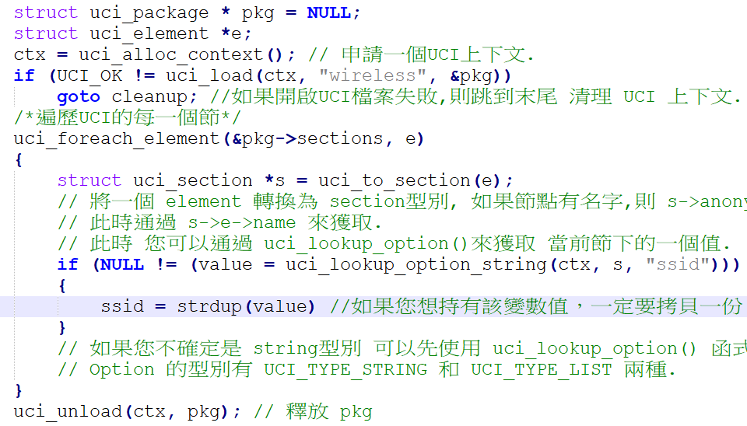
Example UCI C -get value
遍歷package 中的所有section
Get 遍歷到的section中之
SSID的值

Slide 42
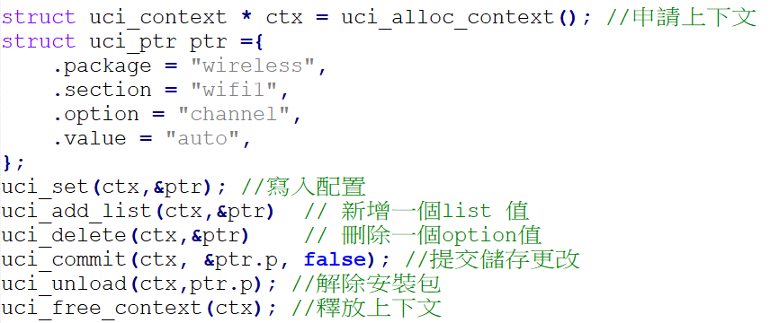
Example UCI C API
用於存放新增或修改的內容
設定、新增、刪除值
Commit 修改
並且release resource

Slide 43
Reference
https://openwrt.org/docs/techref/initscripts
https://openwrt.org/docs/guide-developer/config-scripting
https://blog.csdn.net/yudelian/article/details/88094180
https://blog.csdn.net/dxt1107/article/details/115742249
https://blog.csdn.net/fjlhlonng/article/details/120199692
https://blog.csdn.net/wsclinux/article/details/47989493
https://blog.csdn.net/qq_41453285/article/details/102527800
https://blog.csdn.net/qq_41453285/article/details/102545618
https://blog.csdn.net/flexman09/article/details/52033837
https://blog.csdn.net/flexman09/article/details/51546257
https://blog.csdn.net/fjlhlonng/article/details/120199692
https://blog.chaofan.io/archives/openwrt-develop-uci-configuration
https://www.itread01.com/content/1550403572.html
https://www.daimajiaoliu.com/daima/4870d340d100408
https://www.cirmall.com/bbs/thread-96662-1-1.html
https://www.its203.com/article/qq_19004627/79626269
https://www.cxybb.com/article/flexman09/52033837
https://oldwiki.archive.openwrt.org/zh-tw/doc/uci
https://www.796t.com/content/1549522990.html
https://www.796t.com/content/1550403572.html
https://www.796t.com/content/1508768530.html
https://github.com/jkjuopperi/uci/blob/master/uci.h
https://www.twblogs.net/a/5e52a8c3bd9eee2117c2e07a
https://www.twblogs.net/a/5e52a8c3bd9eee2116819626
https://www.cnblogs.com/tfanalysis/p/3688032.html

